Slide 1


JAVA Java Interview boot camp Core concepts
Lecture 20
CHAPTER 19
Collections-Part 6

Slide 2
The Comparator Interface
Comparator interface is used to order the objects of user-defined class.
This interface is found in java.util package and contains two methods.
These are equals( ) and compare( )

Slide 3
Syntax Of compare( ) Method
public int compare(Object obj1,Object obj2)
Compares its two arguments for order.
Returns a negative integer, zero, or a positive integer as the first argument is less than, equal to, or greater than the second.

Slide 4
Important points regarding Comparator
When we are using Comparator , the objects need not compulsorily be Comparable.
For example: We can sort StringBuffer objects using Comparator.
When we are using Comparator , the objects need not be homogeneous also i.e. we can compare heterogeneous objects also

Slide 5
Exercise
WAP using TreeSet to sort Integers in descending order

Slide 6
Exercise
WAP using TreeSet to sort Strings in descending order

Slide 7
Exercise
WAP using TreeSet to sort String and StringBuffer objects in increasing order of length and if length is same then use alphabetical order.

Slide 8
Exercise
WAP using TreeSet to sort Person in alphabetical order of name

Slide 9
Comparable V/s Comparator
For predefined Comparable classes like String , the default natural sorting order is available . If we are not satisfied with that then we can define our own sorting order using Comparator.
For predefined NonComparable classes like StringBuffer , no default natural sorting is available, Thus we can define our own sorting order using Comparator.
For custom classes like Employee,Student,Customer etc the class designer should implement default natural sorting order using Comparable . On the other hand the programmer using the class can define his own sorting order using Comparator

Slide 10
Comparable V/s Comparator
Comparable | Comparator
Available in java.lang package | Available in java.util package
Used for default natural sorting | Used for customized sorting
Contains only one method called compareTo() | Contains two methods called equals() and compare()
Implemented by Wrappers , String , File as well as many other classes | Implemented by only two classes Collator and RuleBasedCollator available in java.text package

Slide 11
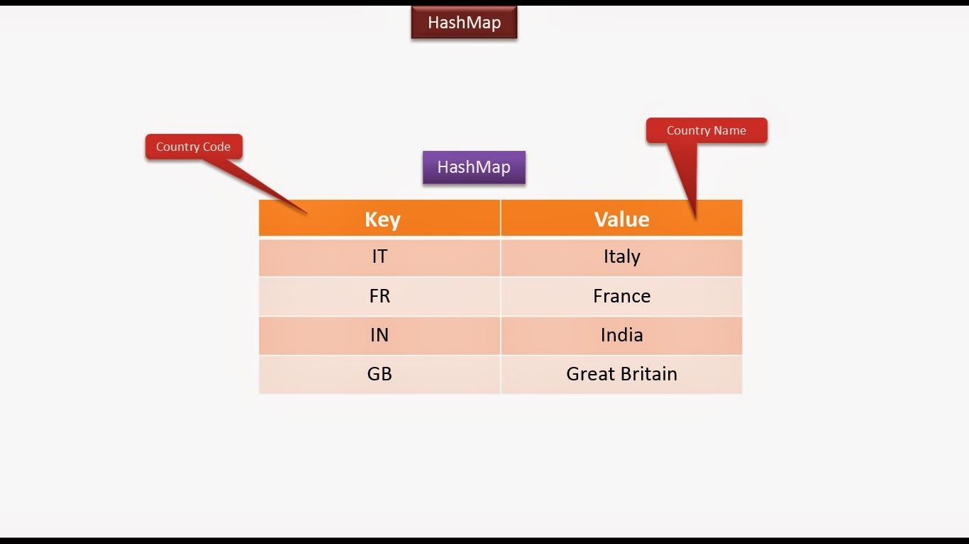
The Map Interface
It is not child interface of Collection interface but has methods similar to Collection
A Map is an object that maps keys to values.

Slide 12
The Map Interface
Mainly used for look ups
Map cannot contain duplicate keys.
Each key can map to at most one value.

Slide 13
The Map Interface
The Map interface includes methods for basic operations such as put() , get(), remove(), containsKey(), containsValue(), size() and isEmpty().
It also provides methods for collection views of it’s contents like keySet(),values() and entrySet()

Slide 14
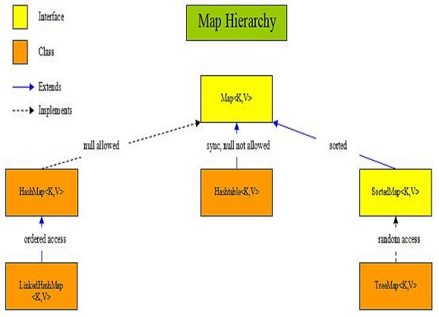
Implementation Classes Of Map

Slide 15
Commonly Used Methods Of Map
void clear( )
Removes all key/value pairs from the invoking map.
boolean containsKey(Object k)
Returns true if the invoking map contains k as a key. Otherwise, returns false.
boolean containsValue(Object v)
Returns true if the map contains v as a value. Otherwise, returns false

Slide 16
Commonly Used Methods Of Map
Set entrySet( )
Returns a Set that contains the entries of the Map. The
set contains objects of type Map.Entry.
This method provides a set-view of the invoking map.
boolean equals(Object obj)
Returns true if obj is a Map and contains the same entries. Otherwise, returns false.
Object get(Object k)
Returns the value associated with the key k.

Slide 17
Commonly Used Methods Of Map
boolean isEmpty( )
Returns true if the invoking map is empty. Otherwise, returns false.
Set keySet( )
Returns a Set that contains the keys in the invoking map. This method provides a set-view of the keys in the invoking map.

Slide 18
Commonly Used Methods Of Map
Object put(Object k, Object v)
Puts an entry in the invoking map, overwriting any previous value associated with the key. The key and value are k and v, respectively. Returns null if the key did not already exist. Otherwise, the previous value linked to the key is returned.
Object replace(Object k, Object v)
Replaces the entry for the specified key only if it is currently mapped to some value. Returns the previous value associated with the specified key, or null if there was no mapping for the key

Slide 19
Commonly Used Methods Of Map
Object remove(Object k)
Removes the entry whose key equals k. Returns the previous value associated with key, or null if there was no mapping for key.
Collection values( )
Returns a collection containing the values in the map. This method provides a collection-view of the values in the map.
int size( )
Returns the number of key/value pairs in the map.

